Slide 1






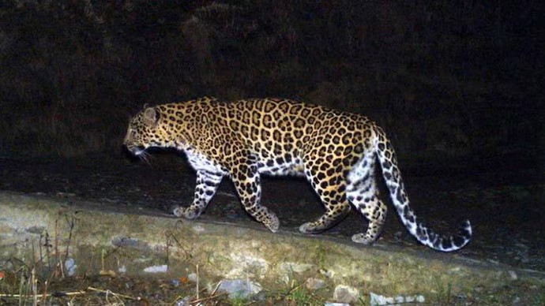
HSF-India HEP Software Workshop at the University of Hyderabad Introduction to parallel programming
Session 1&2
Brij Kishor Jashal
Rutherford Appleton Lab, UK

Slide 2
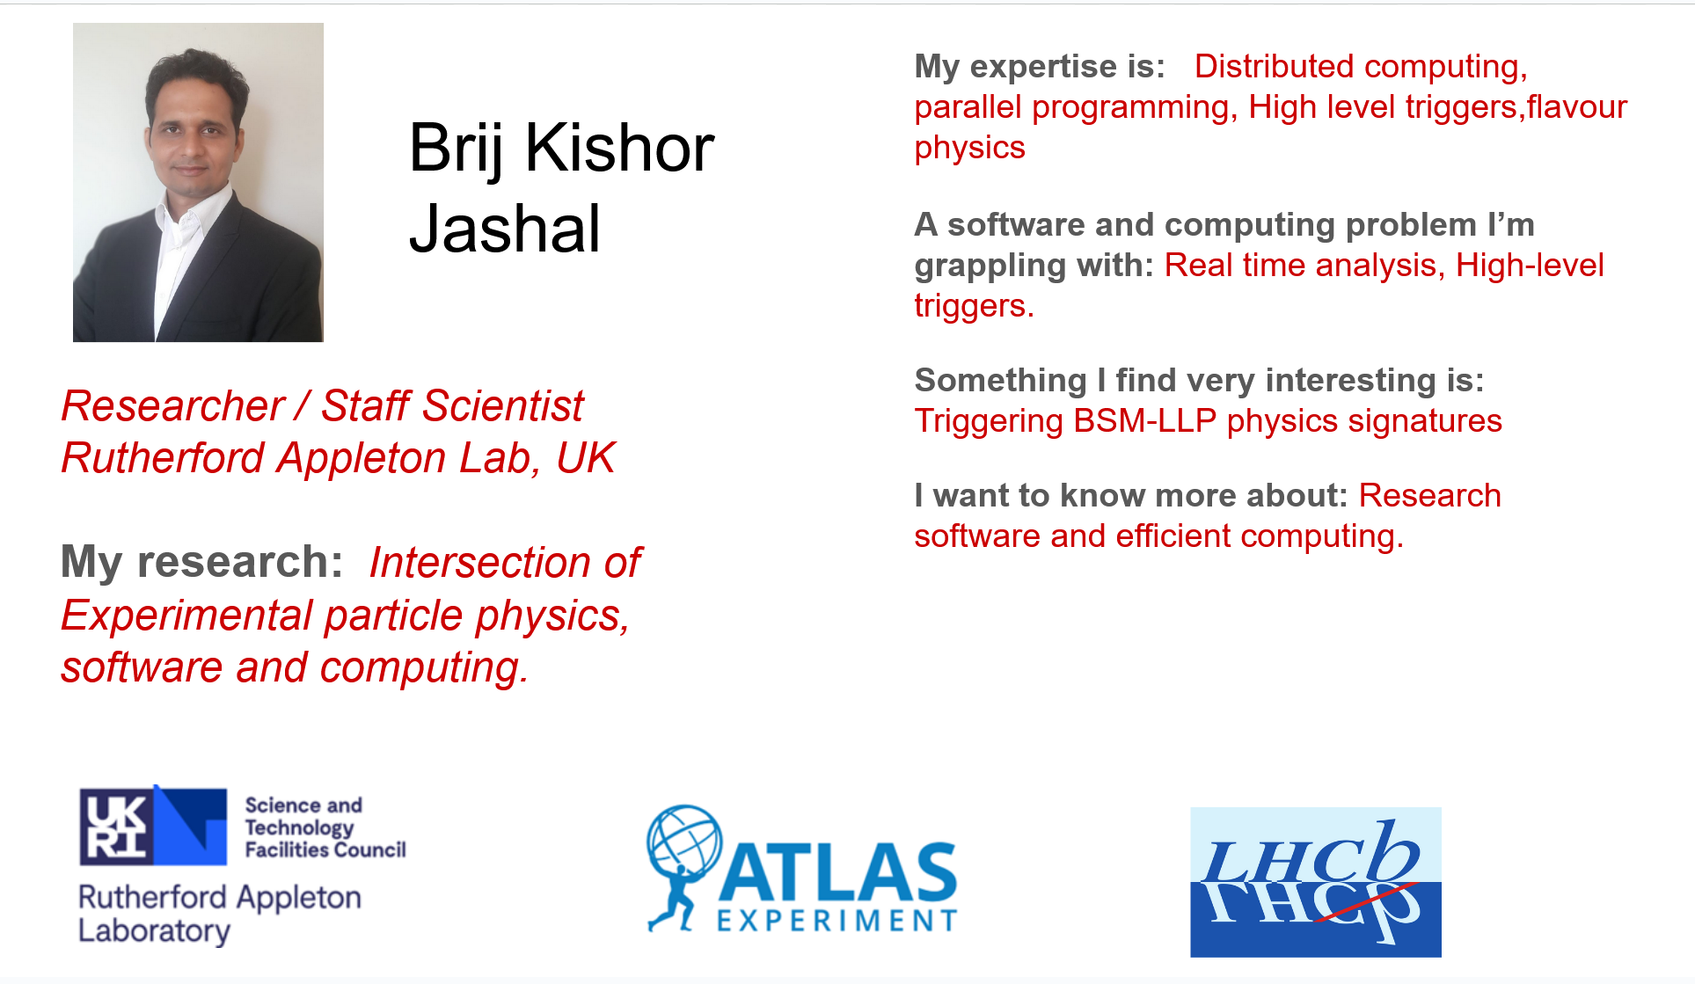

Slide 3
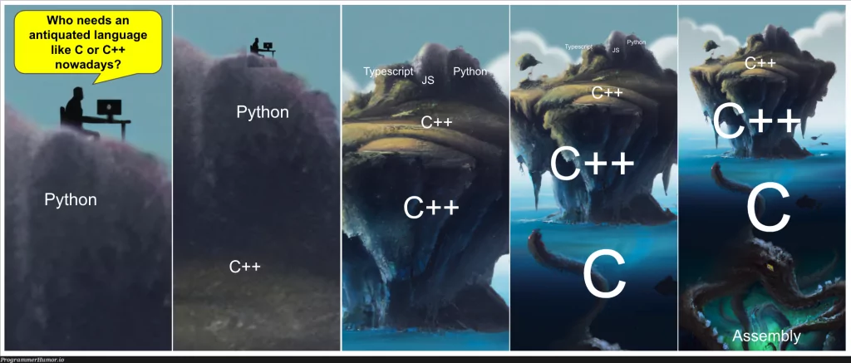

Slide 5
Outline
Session 1: Introduction to GPU computing
Session 2: Fundamentals of Accelerated computing with CUDA C/C++
Session 3: Advanced concepts of GPU computing and parallel algorithms
Session 4: GPU challenge.

Slide 6
Outline
Session 1: Introduction to GPU computing
Parallel computing
Hardware architectures and GPGPUs
Programming languages and libraries

Slide 7
Parallel computing
Ways to speed up an application:
– Reducing the complexity of the algorithm.
– Increasing the speed and capacity of the computing medium: clock frequency.
– Searching for tasks within the application that can be performed in parallel.

Slide 8
Parallel computing
Parallelization of Applications
- Parallelization of certain tasks of our program, so that they are executed simultaneously(threads).
- For this it is necessary to:
–Adapt the application to be executed in parallel.
–Have parallel platforms where to run.

Slide 9
Parallel computing

Slide 10
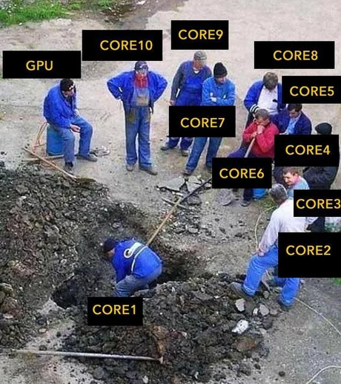
Parallel computing
Types of Parallelism

Slide 11
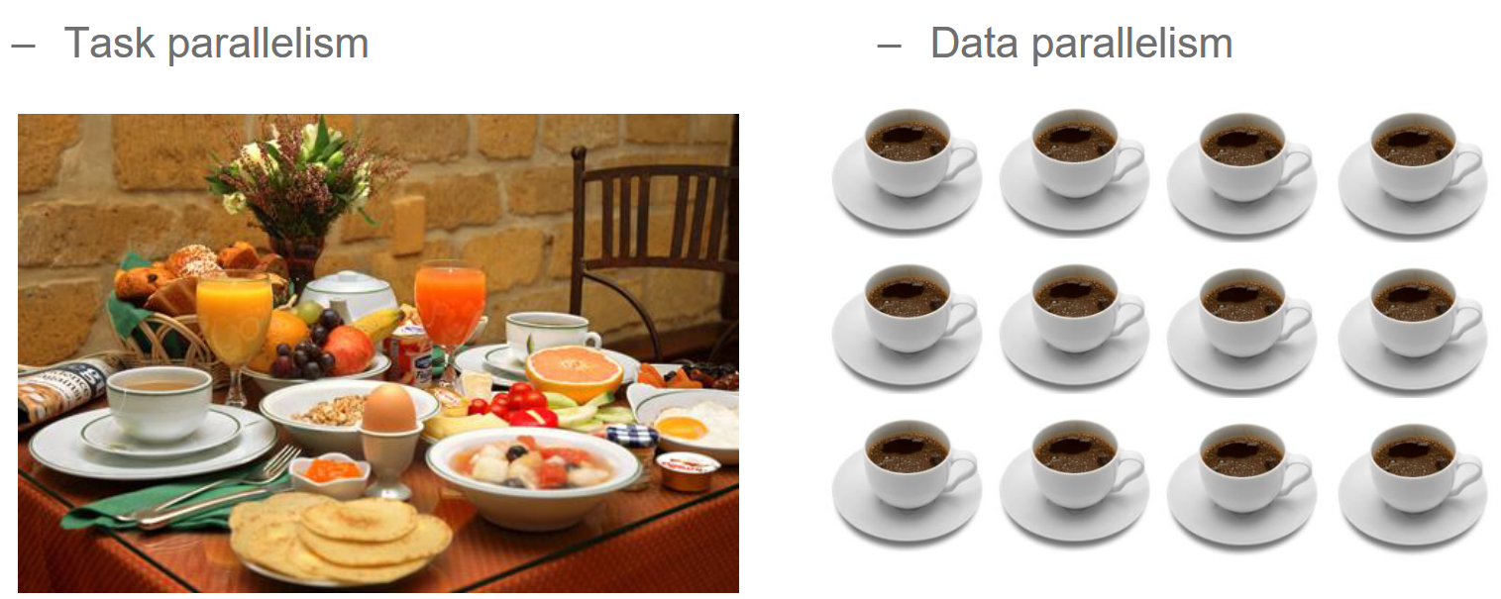
Parallel computing
Types of Parallelism

Slide 12

Hardware architectures and GPGPUs

Slide 13
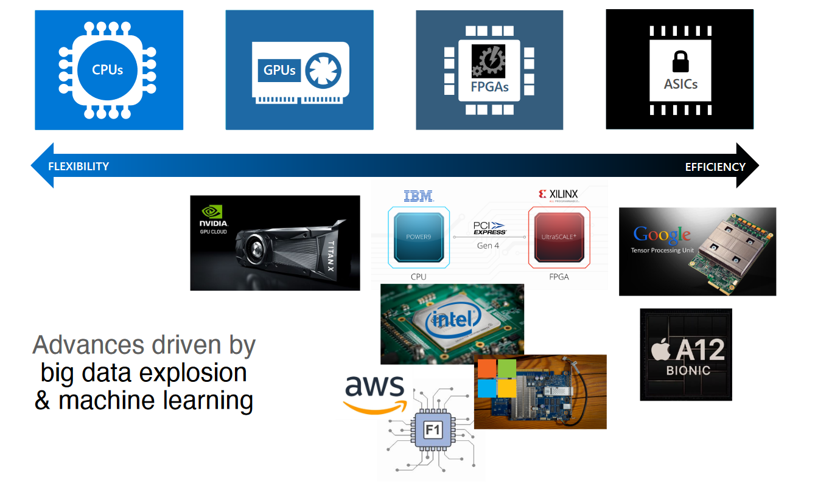
Hardware architectures and GPGPUs

Slide 14
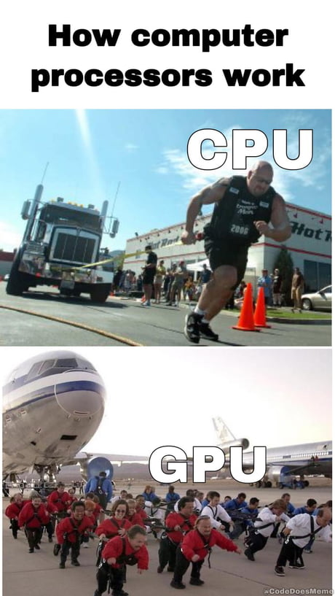
Hardware architectures and GPGPUs
https://en.wikipedia.org/wiki/Graphics_processing_unit
What is the GPU?
– Graphics Processing Unit.
– The processor inside the graphics cards was purpose-specific for graphics only.
– GPGPU: Programming techniques to enable the GPU as a parallel co-processor.
– Currently: Intuitive programming and high amount of resources (e.g. over 16000 cuda cores in RTX4090).

Slide 15
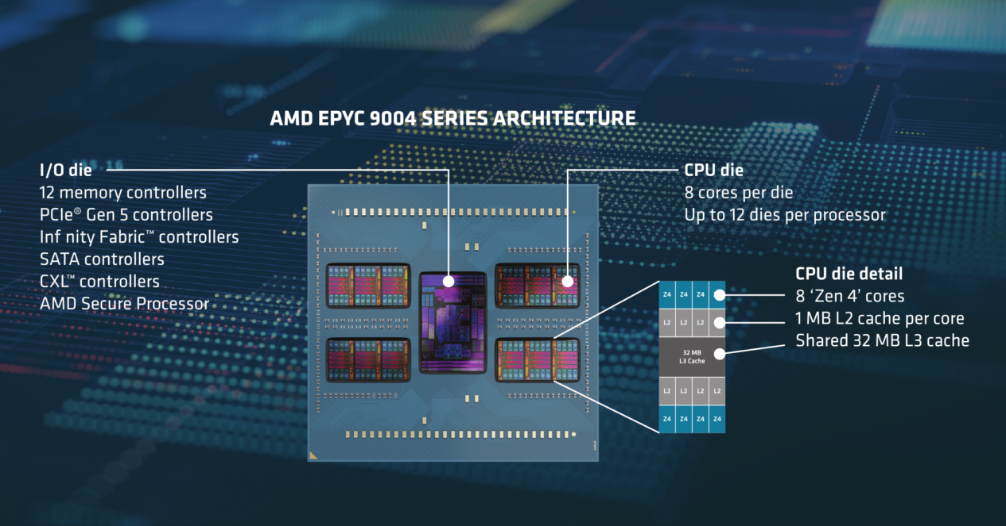
Hardware architectures and GPGPUs
Upto 96 Zen cores

Slide 16
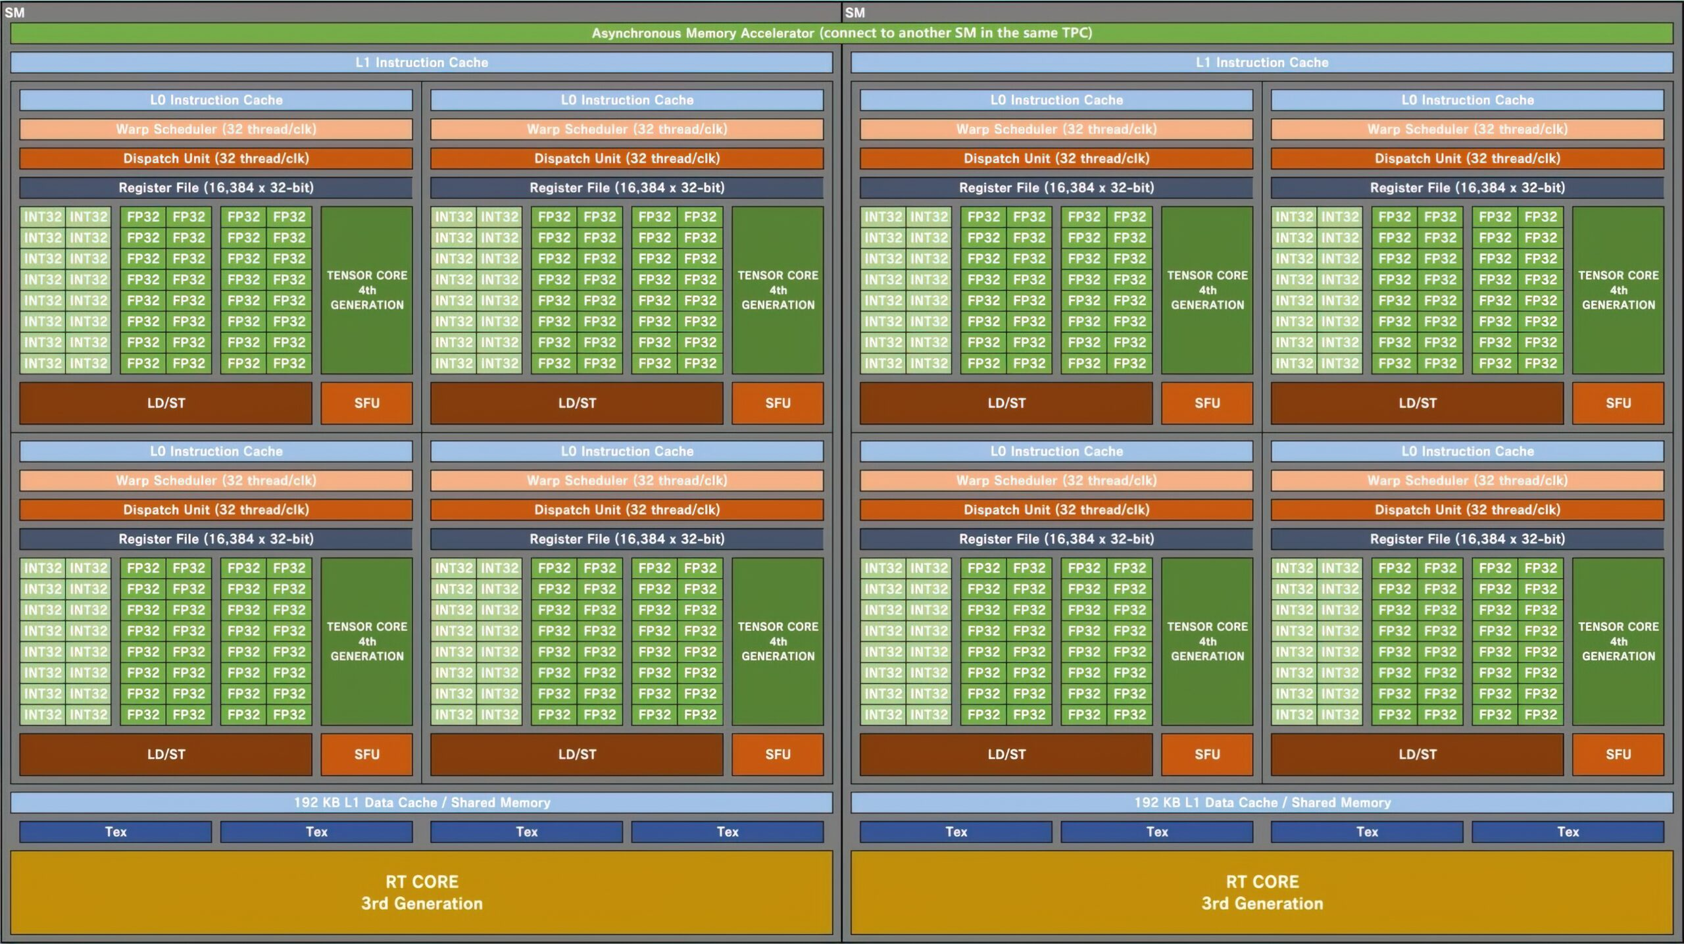
Hardware architectures and GPGPUs
ADA102 - upto 18,453 cuda cores

Slide 17
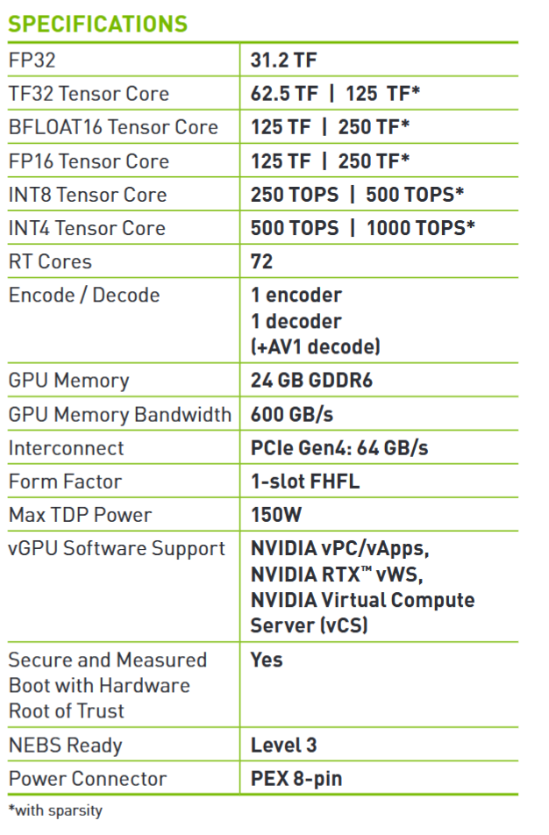
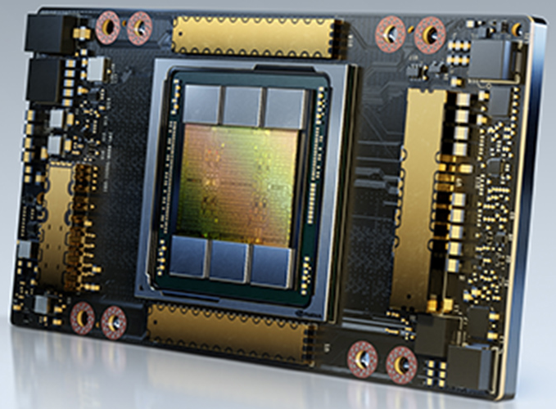
Your GPU (A10)
Upto 18,453 cuda cores

Slide 18
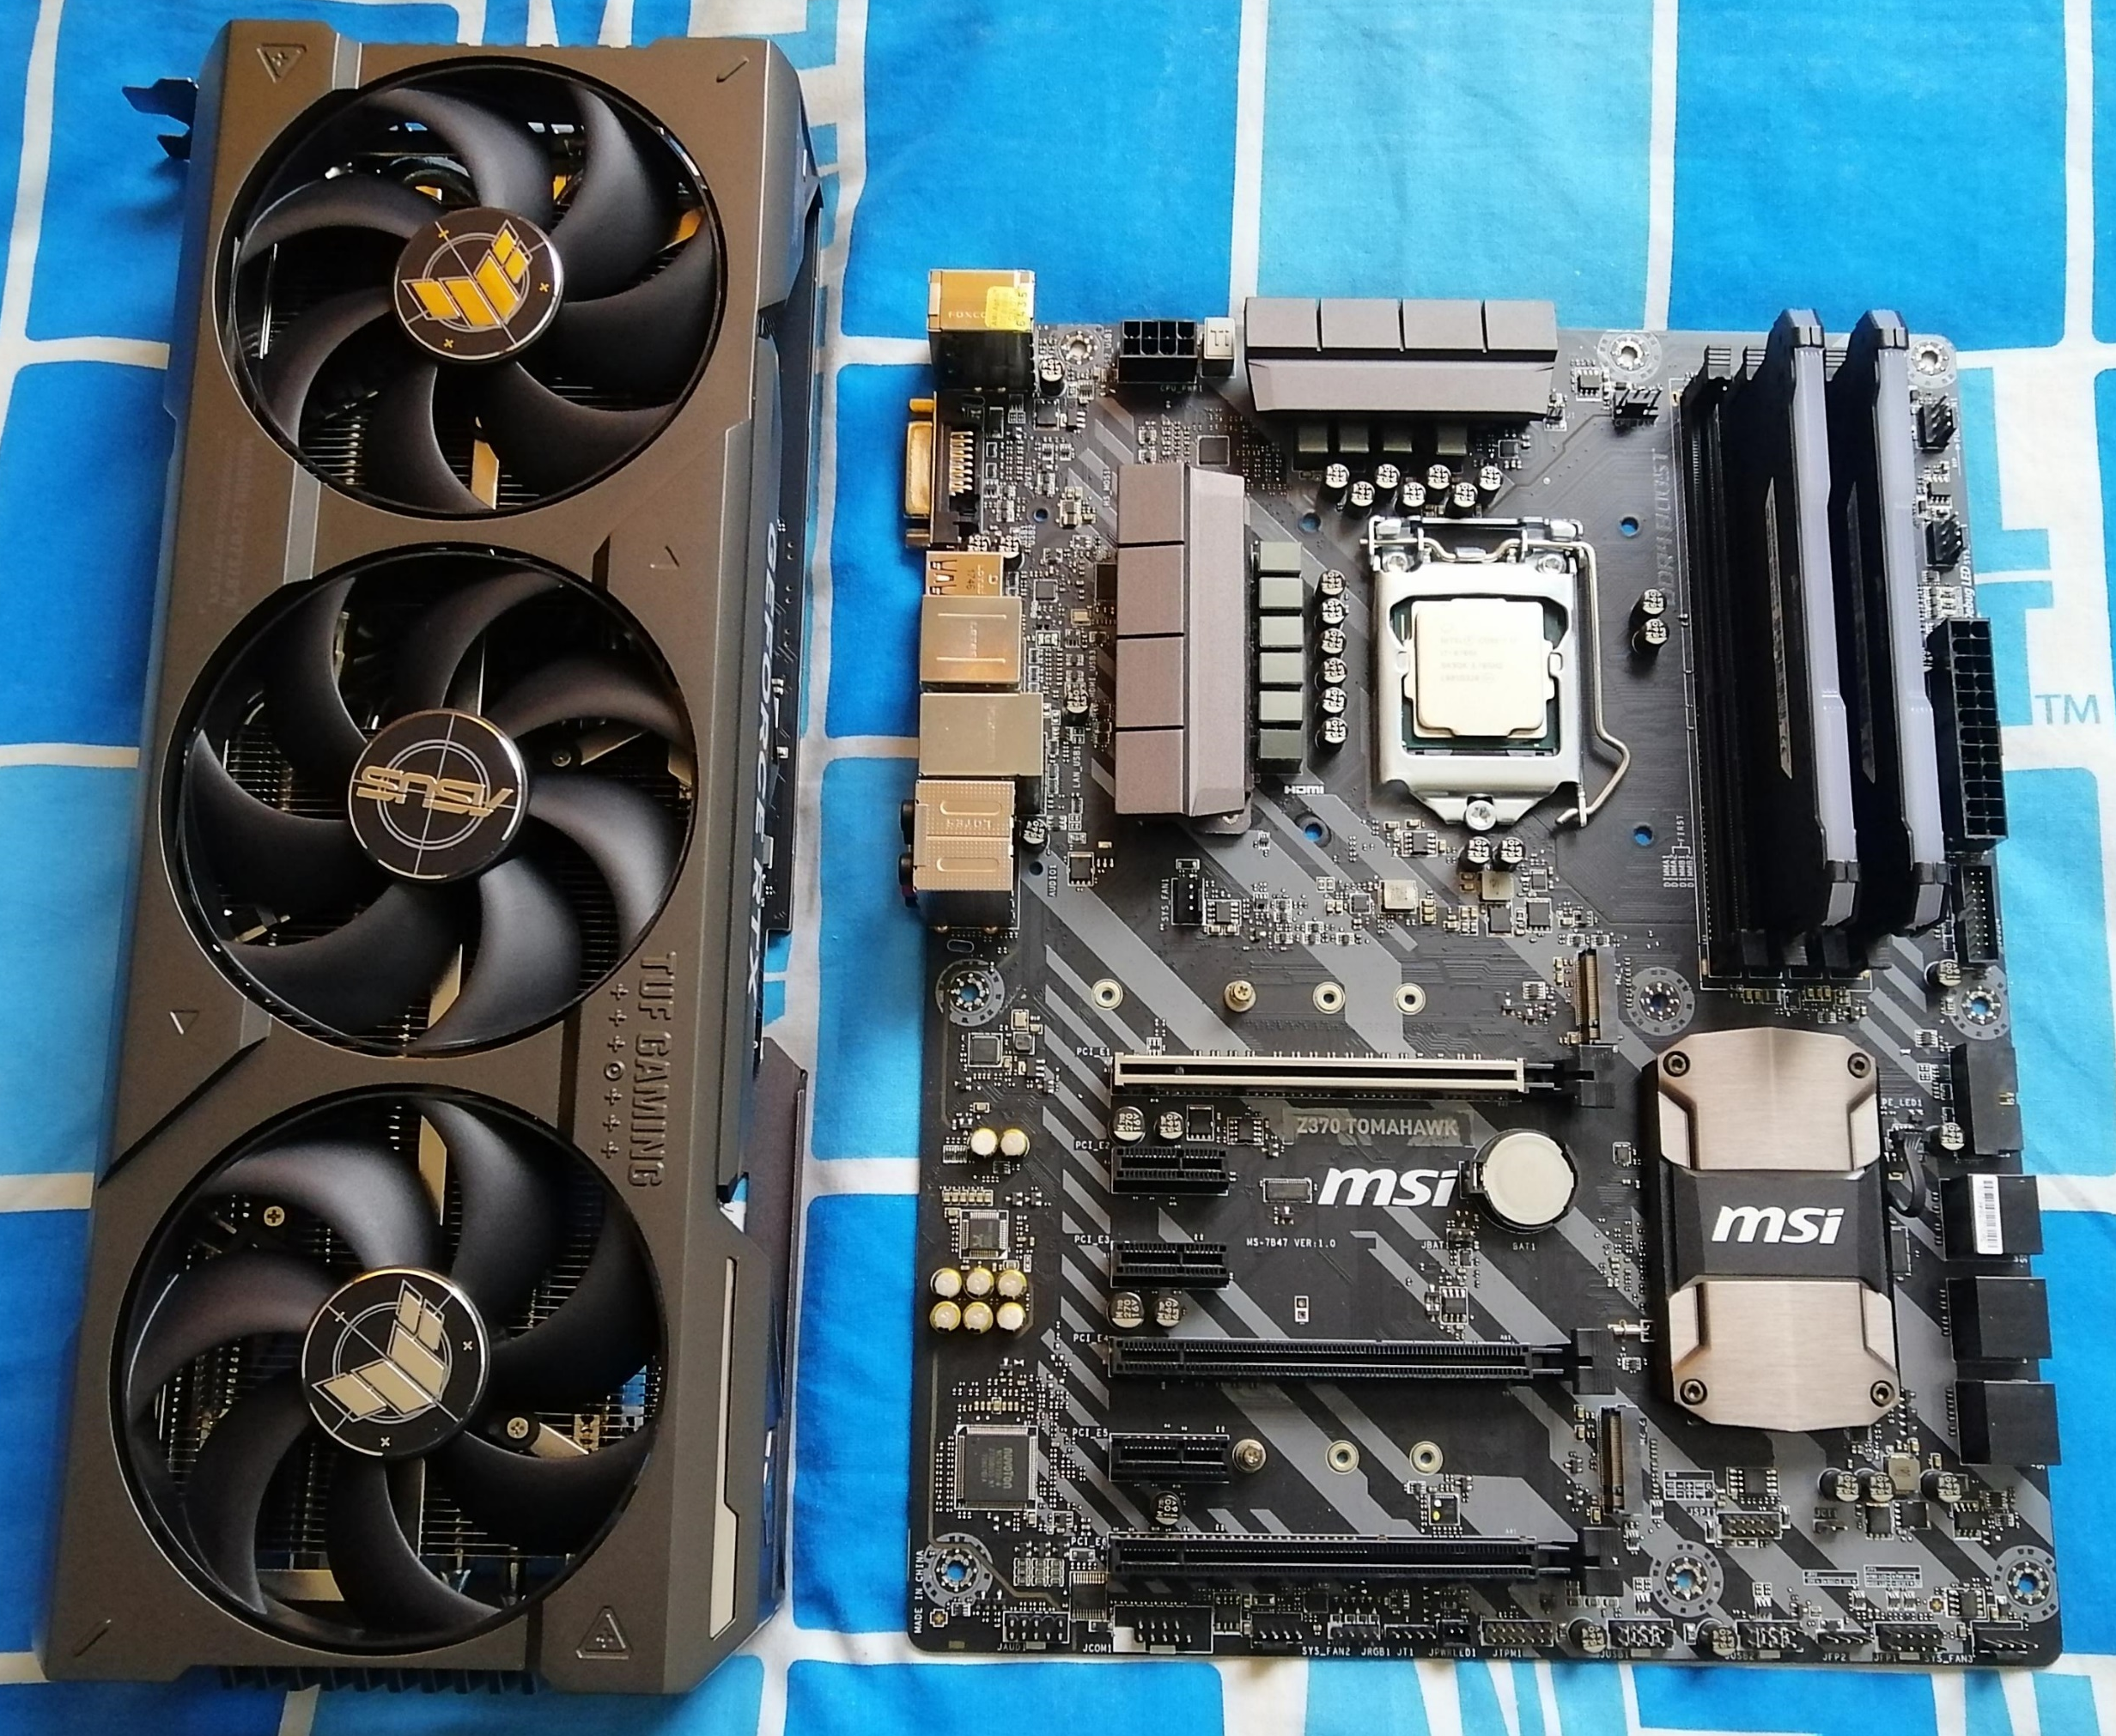
GPU programming

Slide 19
GPU programming
Single Instruction Multiple Data (SIMD) processors
–Massive data parallelism:
–Huge amount of threads processing simultaneously the same instruction over different data.

Slide 20
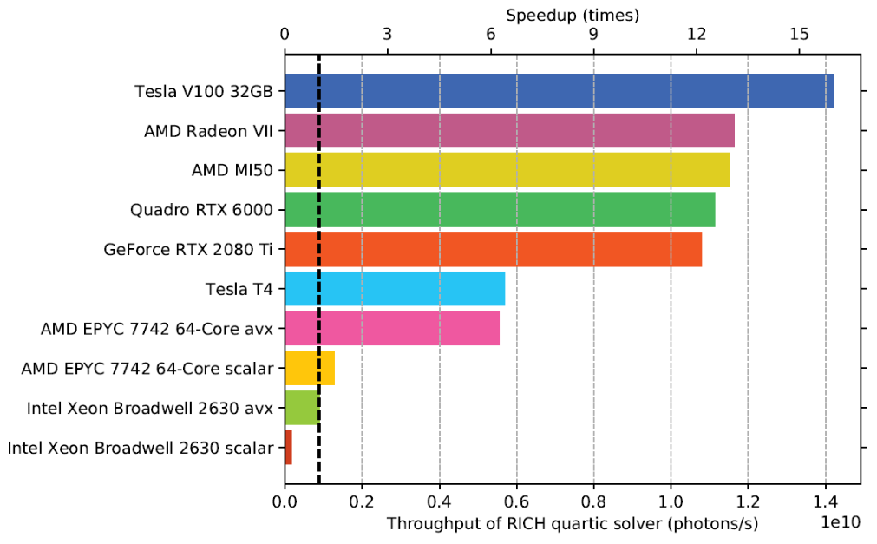
GPU programming
GPGPU today
A mature area:
– Good software ecosystem
– Large support from both industry and developers
– Large community
– A plethora of research papers
Your choice:
– NVIDIA GPUs: CUDA, OpenCL, OpenAcc
– AMD GPUs: OpenCL, HIP
– Intel GPUs: OpenCL
In this course we will focus on the most adopted technology: CUDA
–Why? Mature software ecosystem as well as hardware

Slide 21
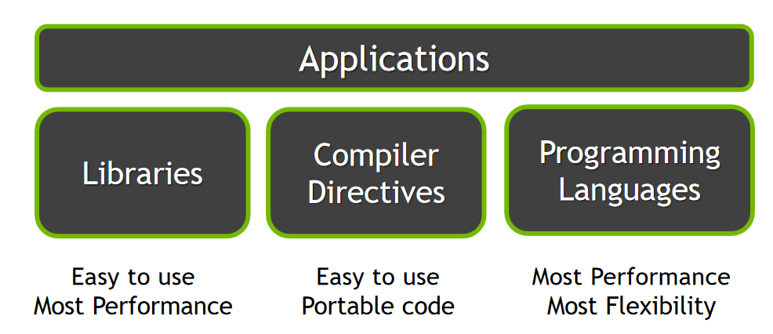
GPU programming

Slide 22
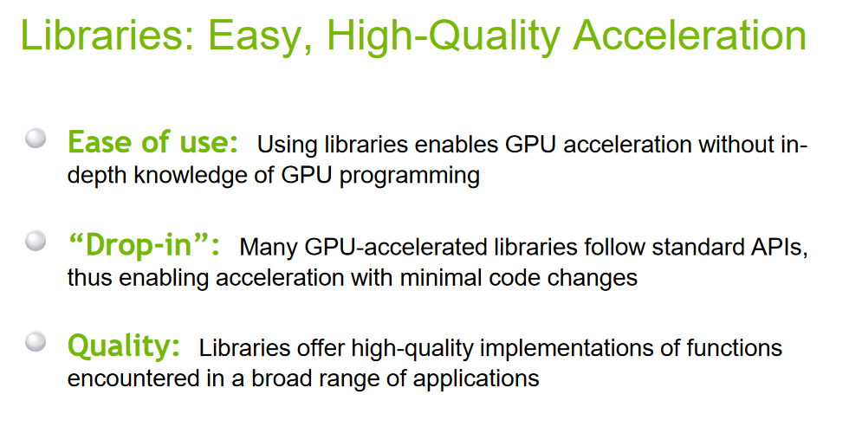
GPU programming: Libraries

Slide 23
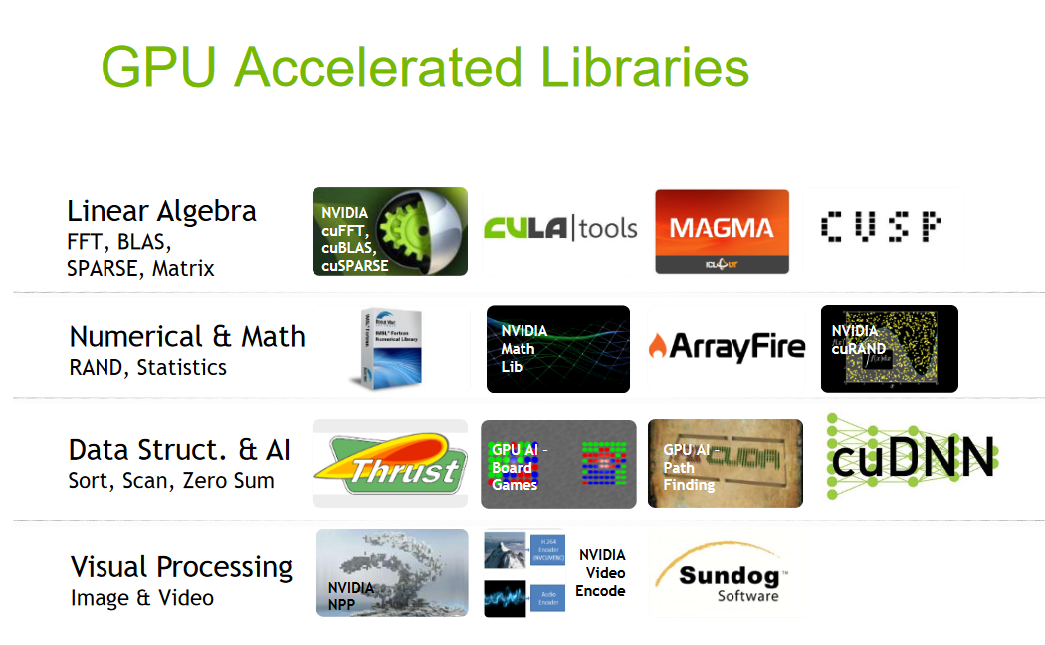
GPU programming: Libraries

Slide 24
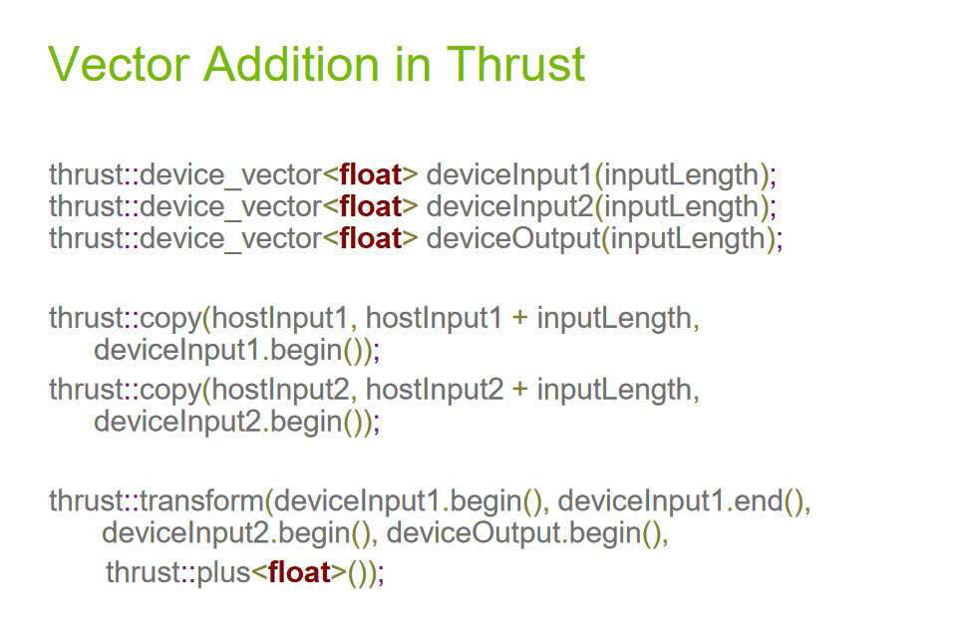
GPU programming: Libraries

Slide 25
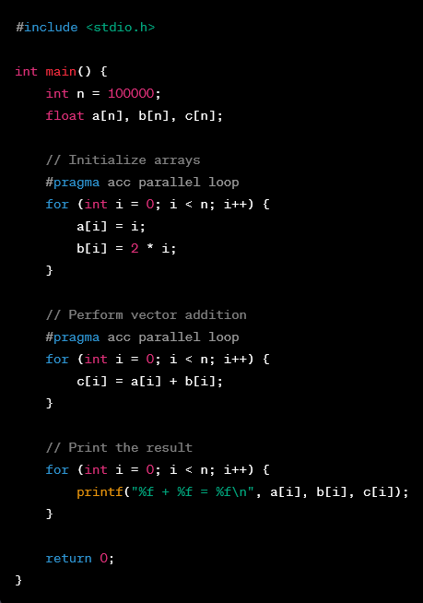
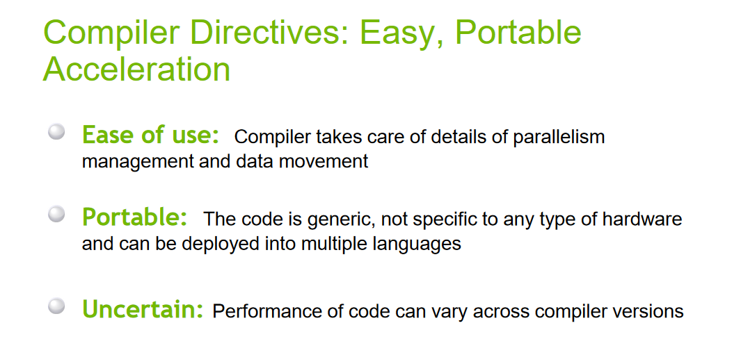
GPU programming: Compiler Directives

Slide 26
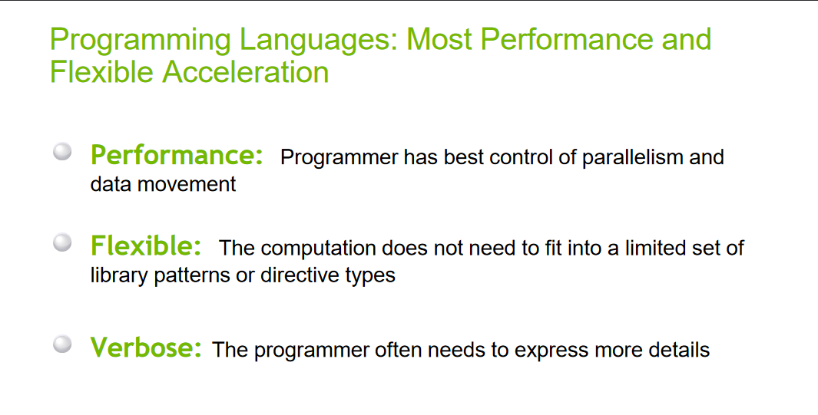
GPU programming: Languages

Slide 27
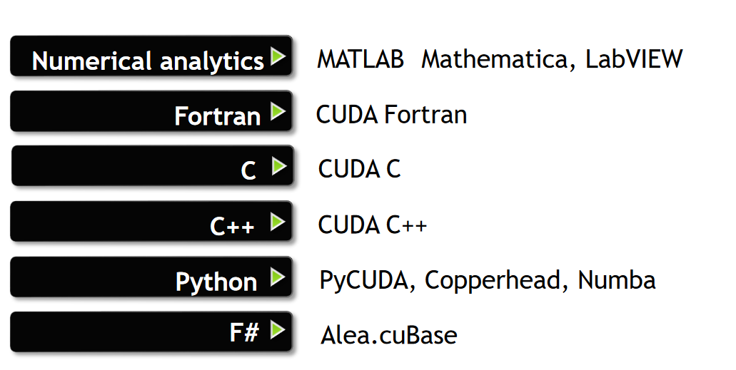
GPU programming: Languages

Slide 28
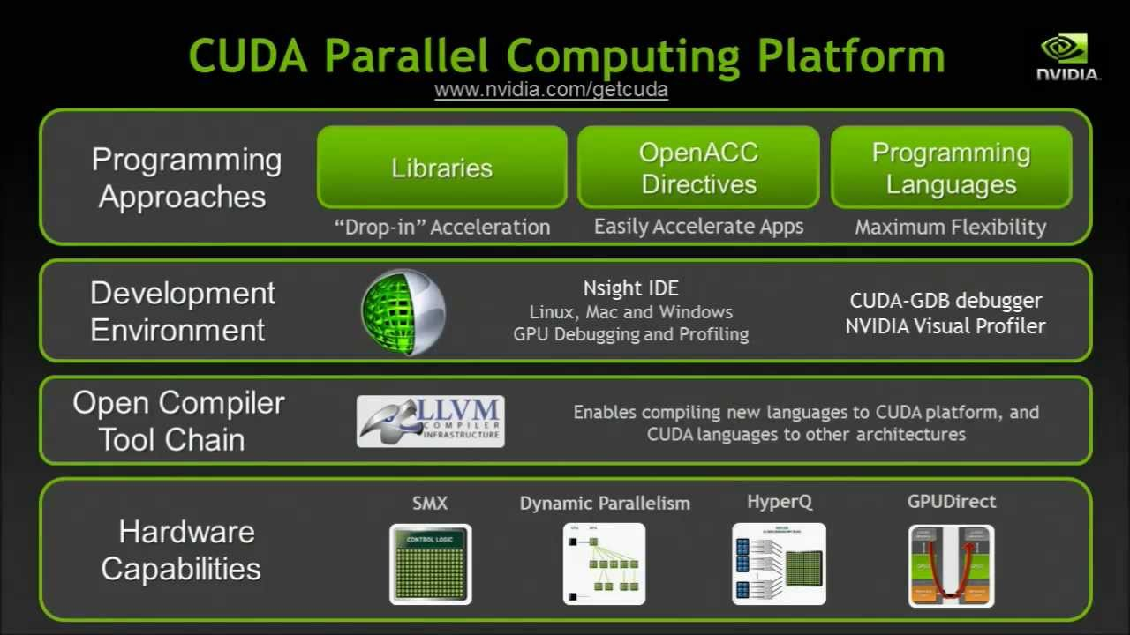
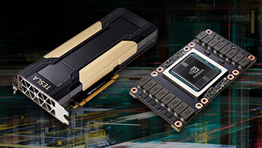
NVIDIA CUDA
– CUDA = Compute Unified Device Architecture
–“A platform designed jointly at software and hardware level that allows the programmer to take advantage of the power of a GPU in general purpose applications”

Slide 29
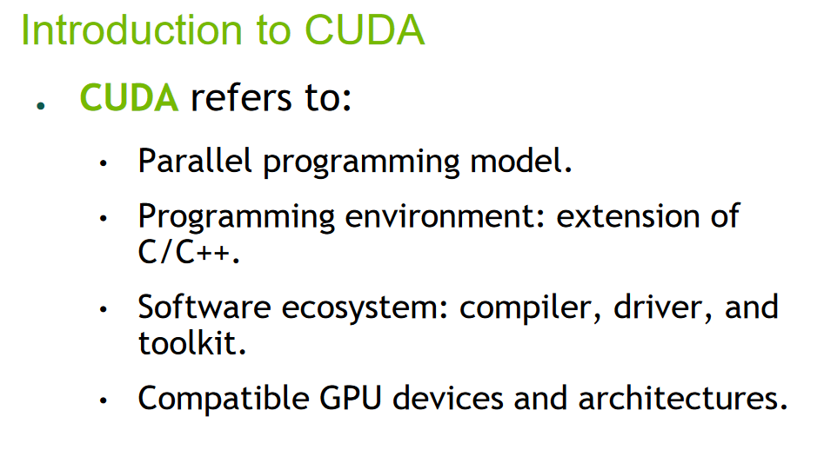
NVIDIA CUDA

Slide 30
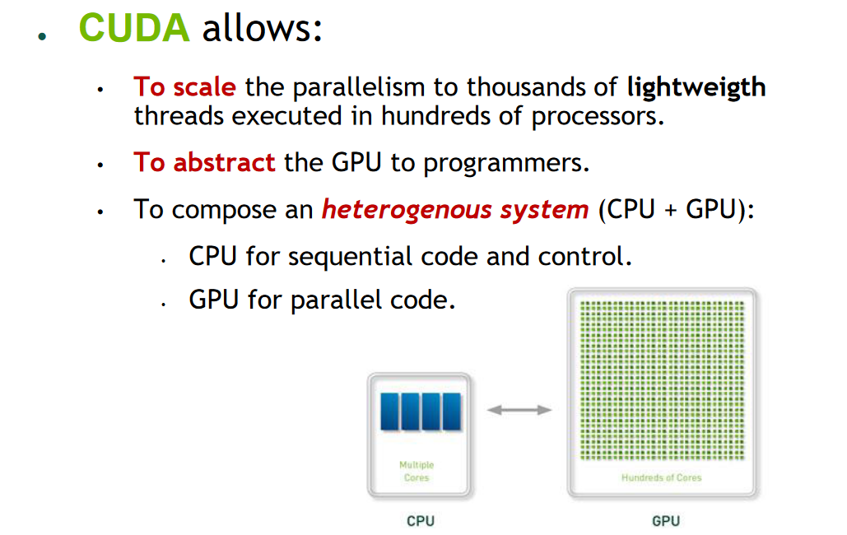
NVIDIA CUDA

Slide 31
NVIDIA CUDA
Some definitions of the model:
Host, Device, Kernel
Compute Capability
Warp(32 threads)
Threads very lightweigth execution units
Simple and lightweight primitives for syncronization.

Slide 32
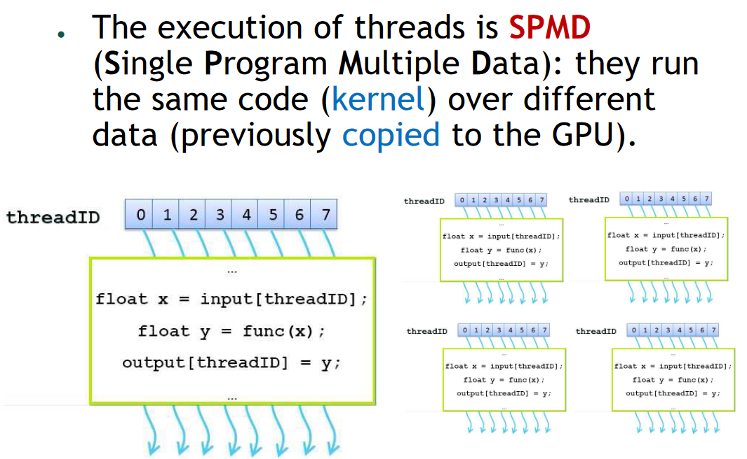
NVIDIA CUDA: Threads

Slide 33
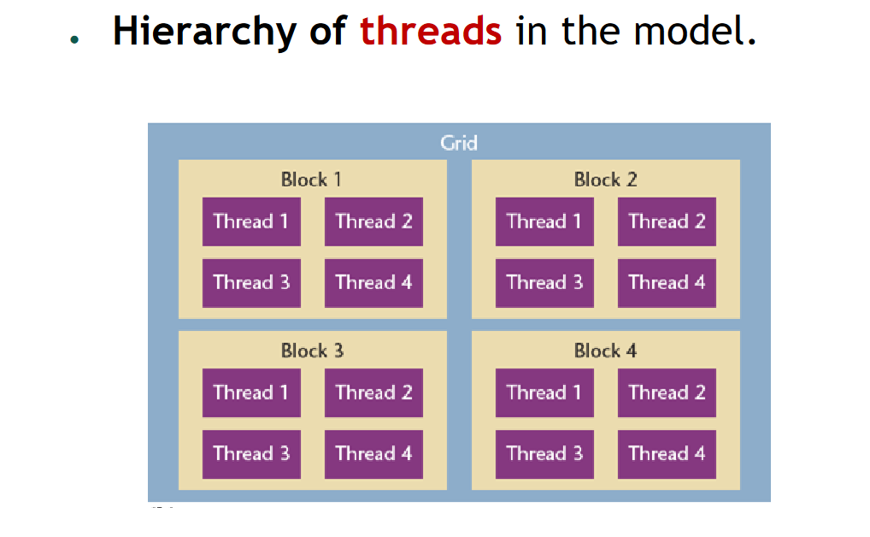
NVIDIA CUDA: Thread block

Slide 34
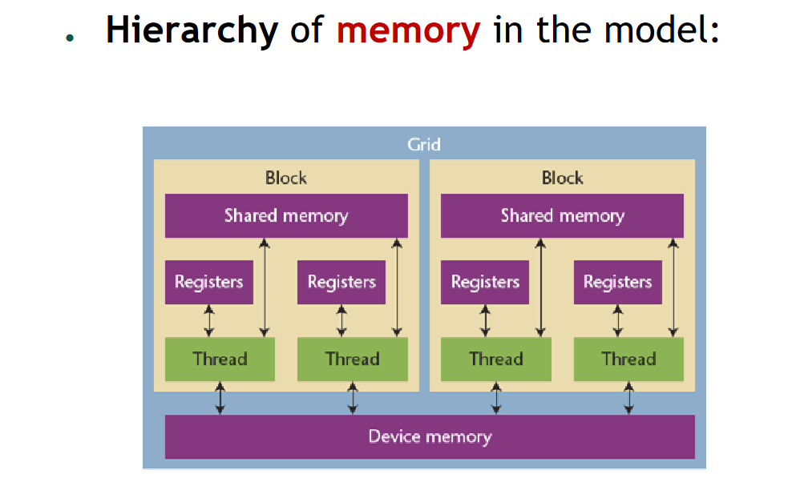
NVIDIA CUDA: Thread Block Memory

Slide 35
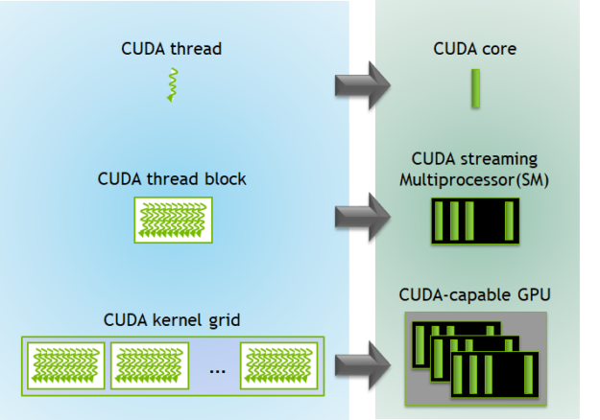
NVIDIA CUDA: Thread Block Memory to device
Programmers view
Hardware view

Slide 36
CUDA Toolkit
CUDA Toolkit (now12.4):
Nvcc compiler for C/C++, cuda-gdb debugger
Visual Profiler, Parallel Nsight
Libreries: BLAS, FFT, SPARSE, RAND, MATH, THRUST...
Documentation.
CUDA Samples:
Codesamples: matrices, vectors, fluids, etc.
Some helper headerfiles.
http://developer.nvidia.com/

Slide 37
Instructions for hands-on sessions
Instructions link
Course repo –
https://github.com/hsf-india-january2025/GPUCuda

Slide 38
NVIDIA CUDA: Resources
Learn more
Official web page and programming model guide:
https://developer.nvidia.com/cuda-zone
Training and courses: https://developer.nvidia.com/cuda-training
NVIDIA Deep Learning Institute: https://courses.nvidia.com/courses
hgpu.org –Database with related Works on GPU
Google Colab: https://colab.research.google.com
Using GPUs on the cloud for free, based on Jupyter and Python.

Slide 39
Some of the slides of this presentation are taken from the GPU Teaching Kit, which is licensed by NVIDIA and the University of Illinois under the Creative Commons Attribution-NonCommercial 4.0 International License.

